Slide 2

AB road, an inter’estrain microbiome
Michael Sieler
Sharpton Lab
May 25th, 2022

Slide 3
Outline
Strain
Are there differences in microbiome diversity and composition?
Pathogen Exposure
Does exposure or presence of worms impact the microbiome?
Are there strain dependent effects on the microbiome?

Slide 4
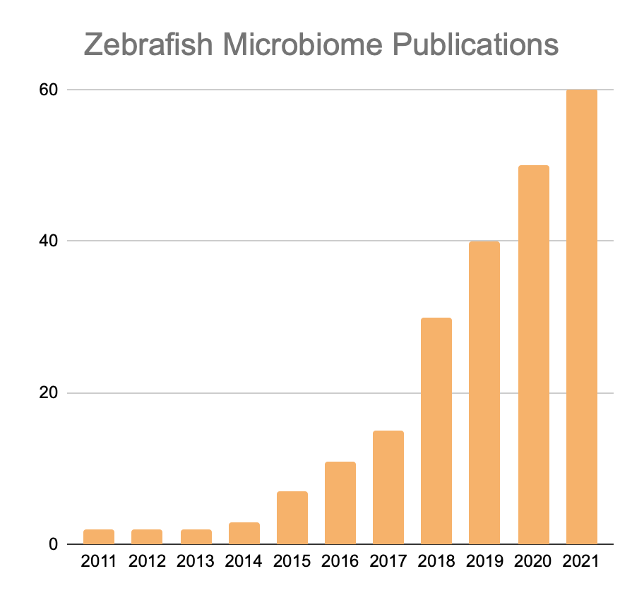
Zebrafish are an important research model
Used as a model organism since 1970’s
Benefits of using zebrafish:
Extensive homology to early human development, genetics, and biochemistry
Established, high-throughput methods
Large sample sizes
Ease of directly manipulate microbiome
Becoming popular in microbiome research
Source: Web of Science
Notes:
Gaining a clearer picture of whether or not diet impacts the microbiome to influence host health is critical due to zebrafish becoming an emerging fundamental microbiome research model.
[1] Zebrafish as a model system offer many benefits, to list a few:
-Extensive homology…
-Establish, high-throughput methods…
-Large sample sizes…
-Ease of directly manipulating…
[2] Given what we know about the influence diet has on host physiology and the microbiome’s important role in mediating host health, it raises important questions about whether or not we need to consider diet in microbiome-targeted zebrafish studies.
There has been a little work in the zebrafish model that indicates that diet does matter…

Slide 5
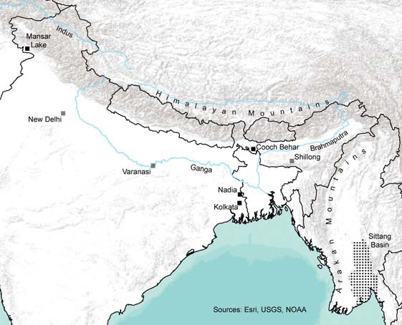
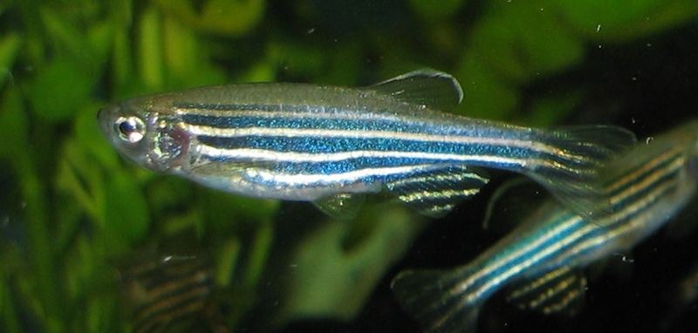
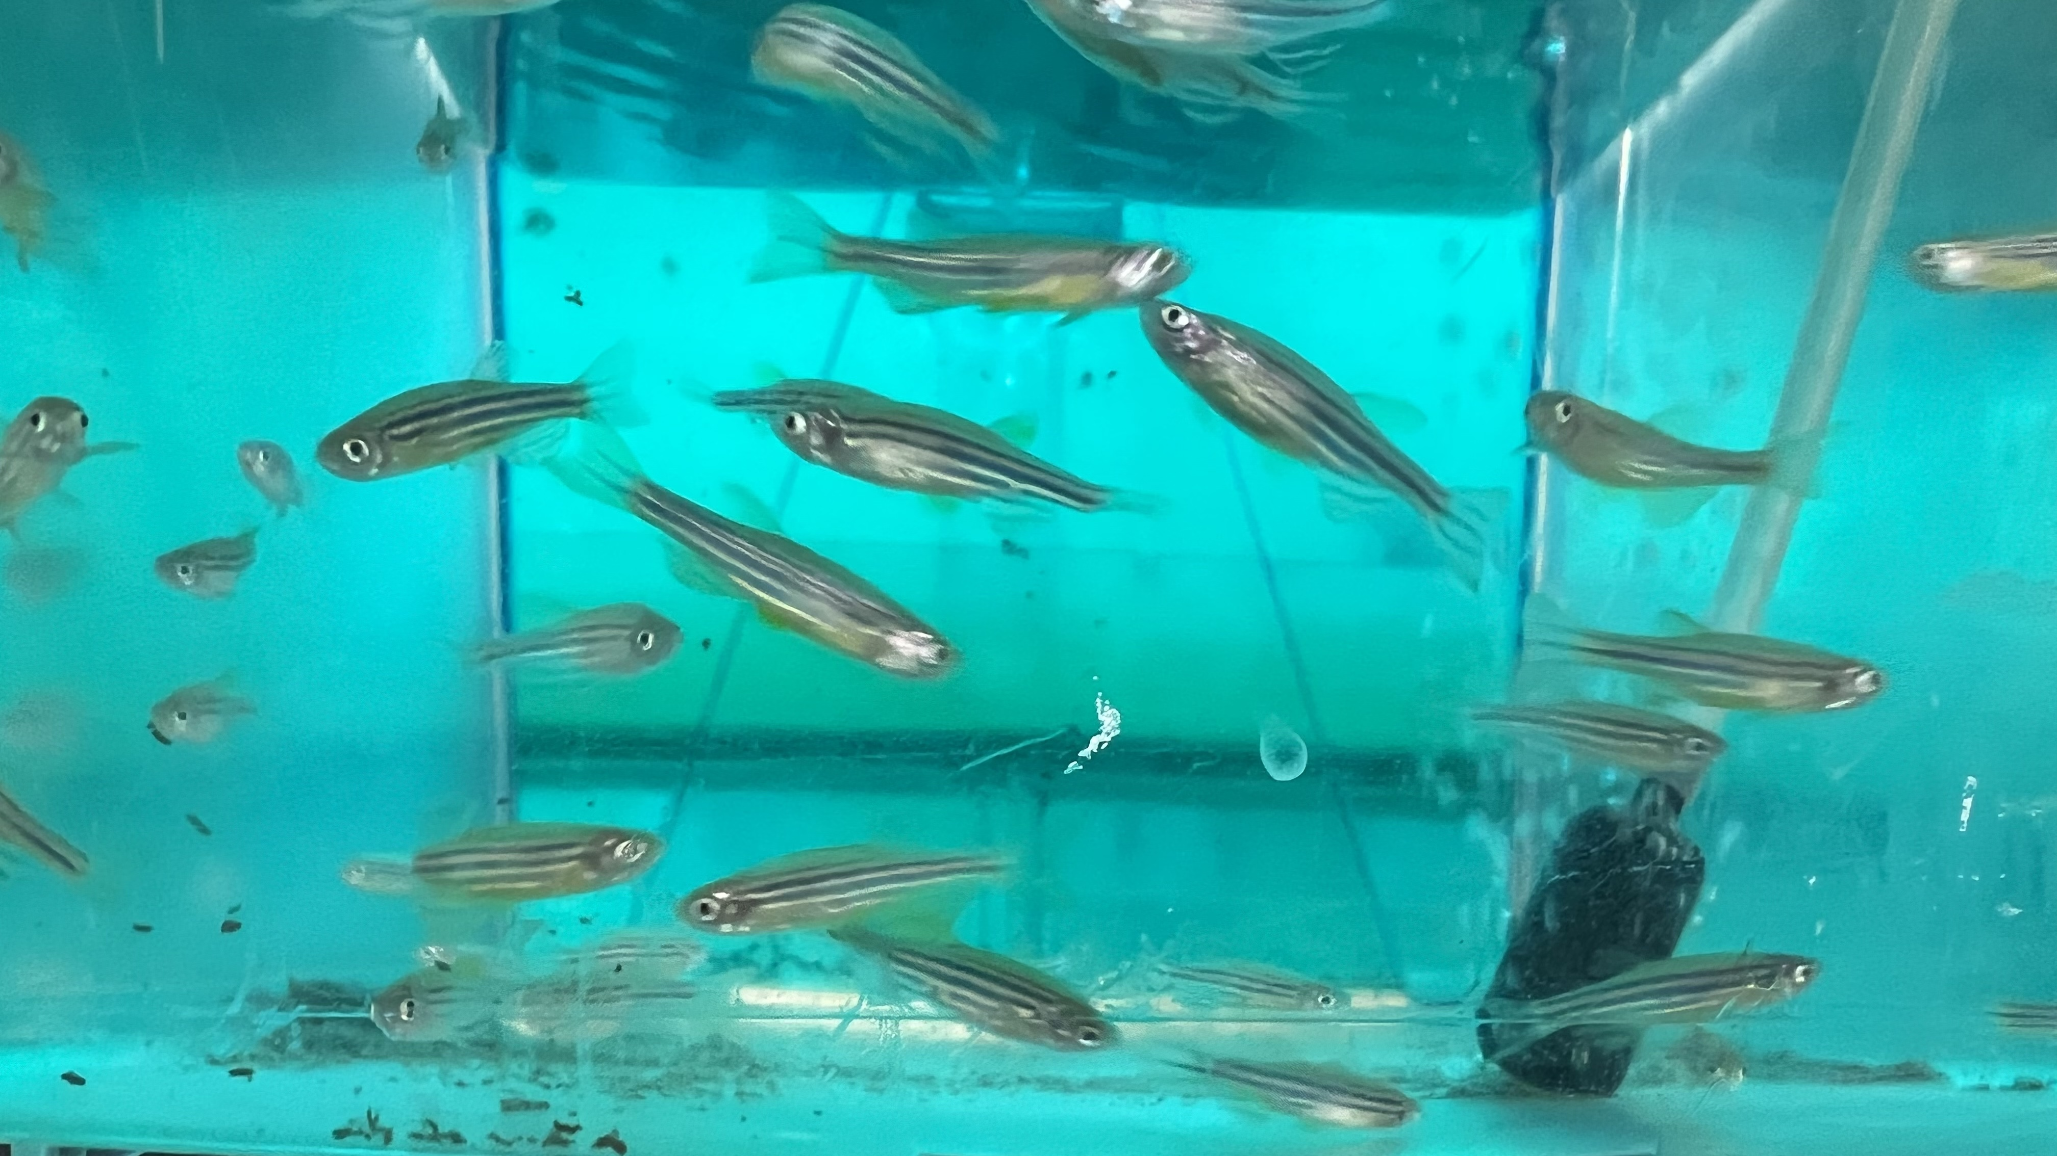
Zebrafish are endemic to South Asia

Slide 6
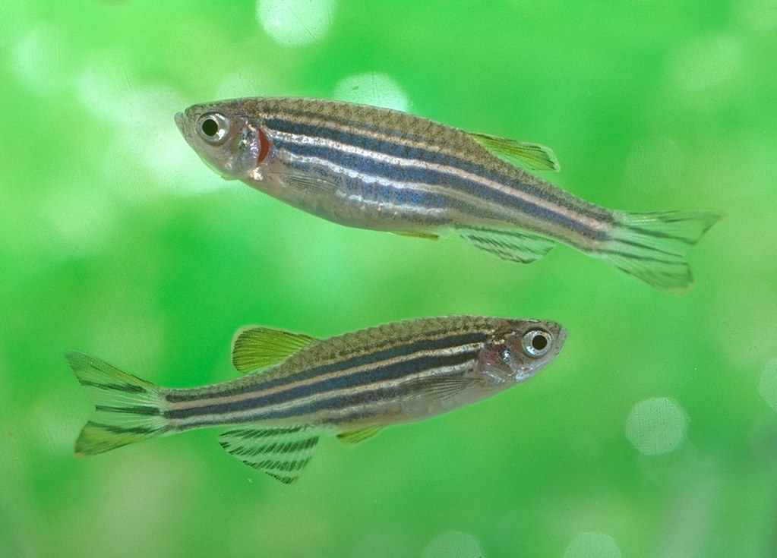
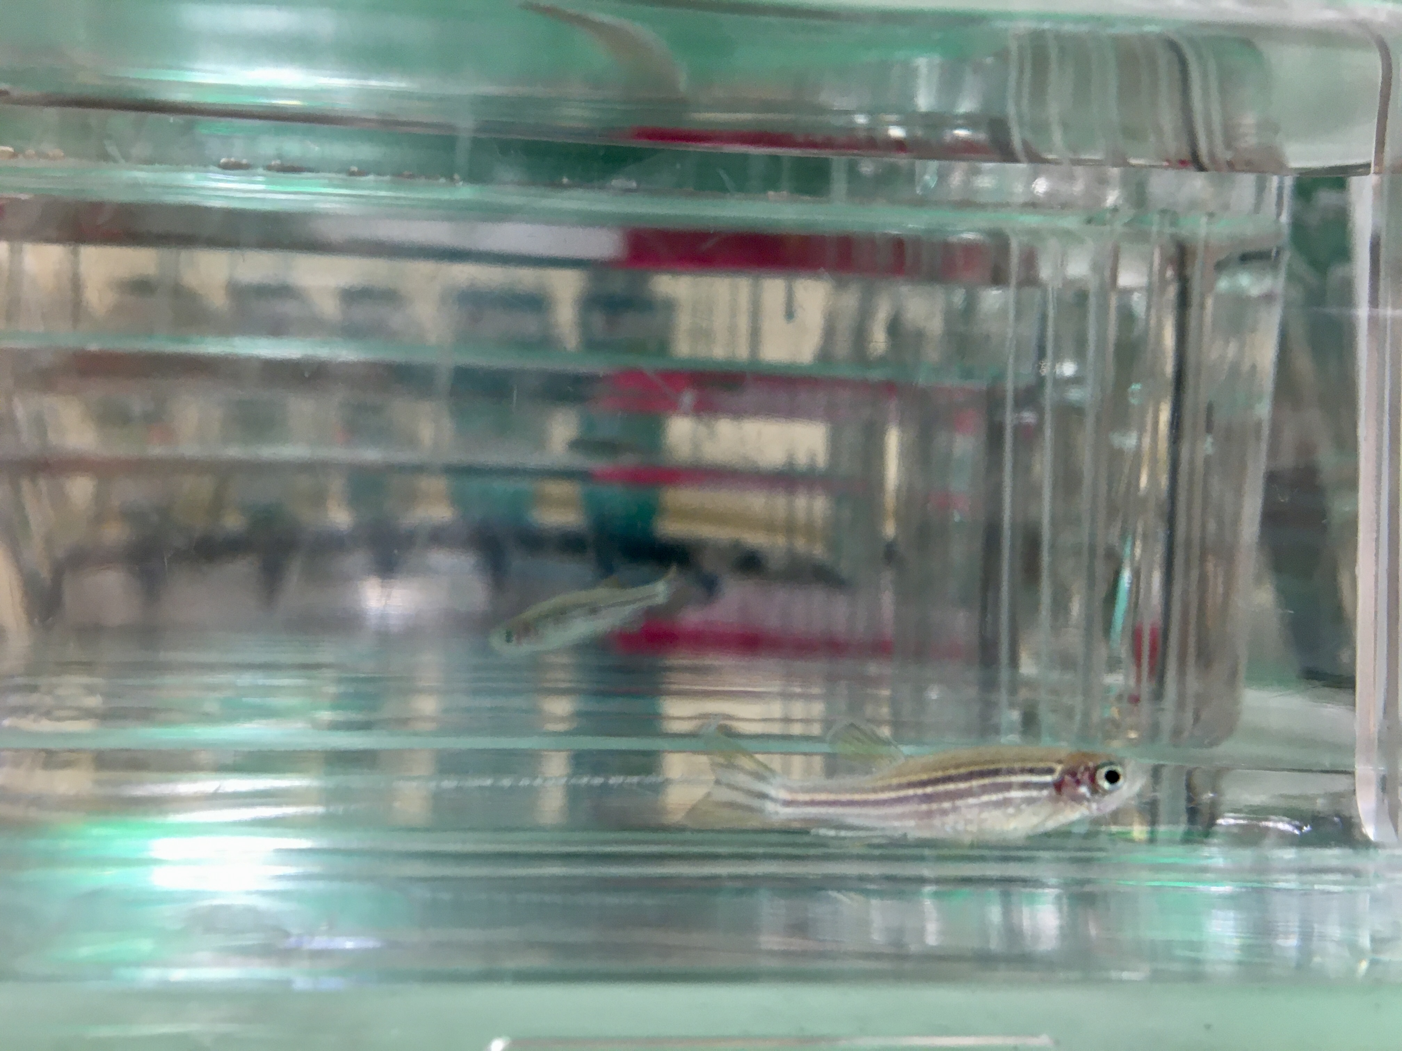
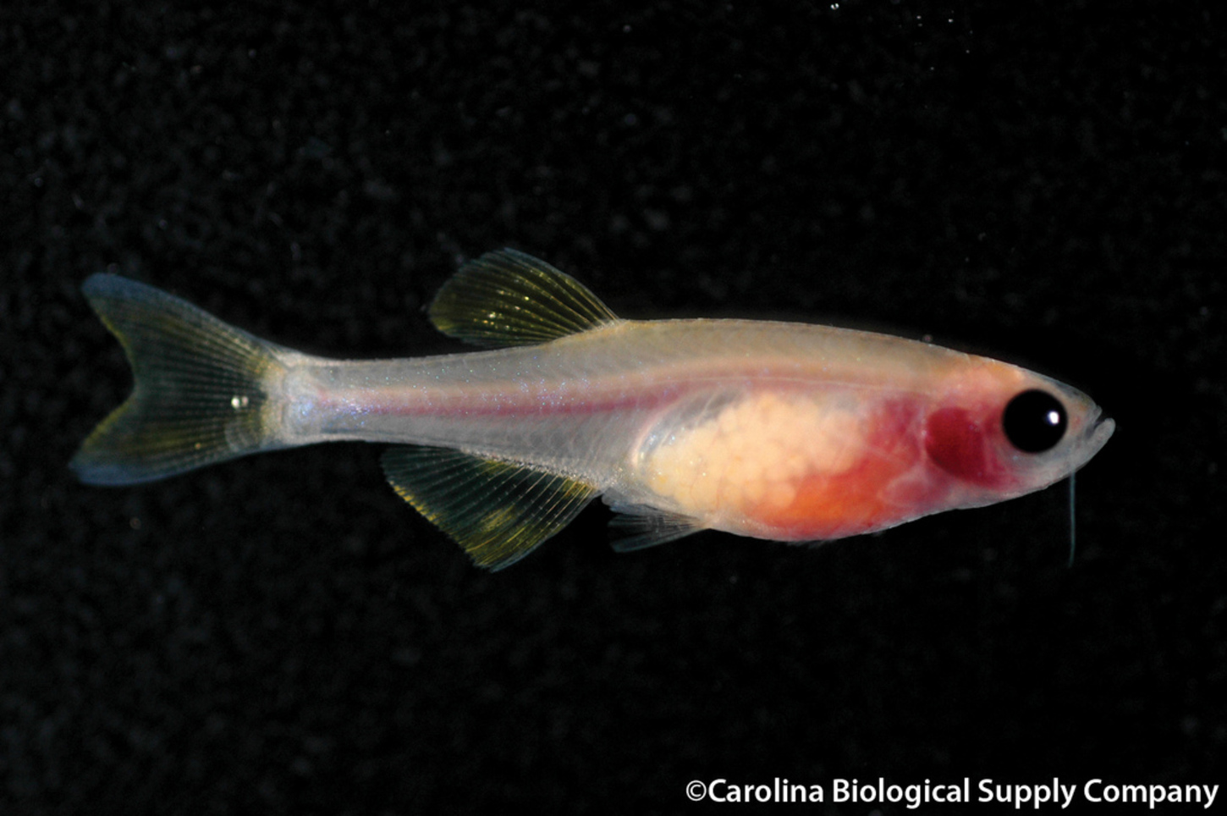
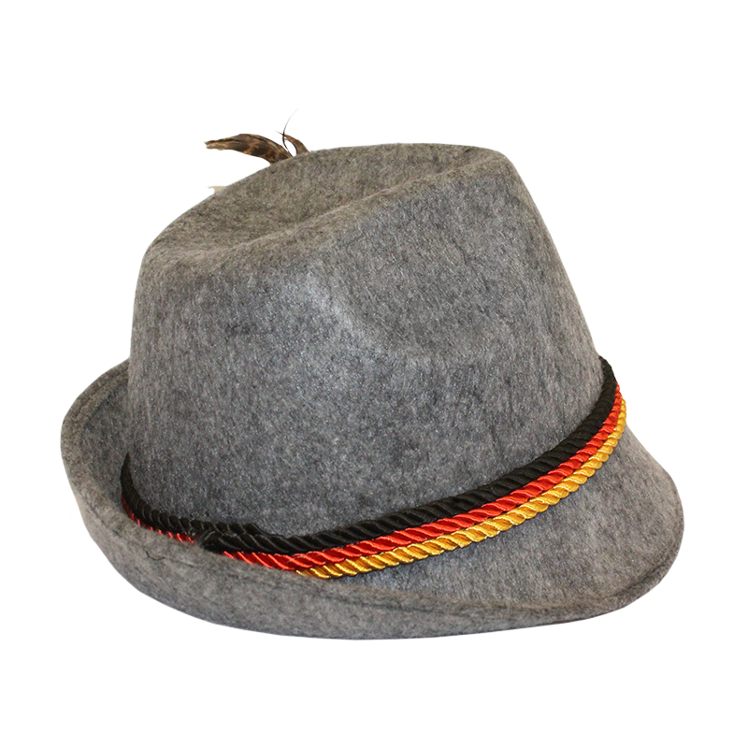

Common laboratory zebrafish strains
AB
5D
Casper
TU*
* Artist rendition
Notes:
AB most inbred, The AB line is derived from two lines, A and B, purchased by Streisinger in the 70’s at from a pet shop in Albany, Oregon.
5D most outbred, came from a tropical fish store
Casper, mutation that created see-through skin, used in cancer research for mutations
TU (not shown), originated from a pet store in Tuebingen, Germany. Strain used by Sanger for the zebrafish sequencing project

Slide 7
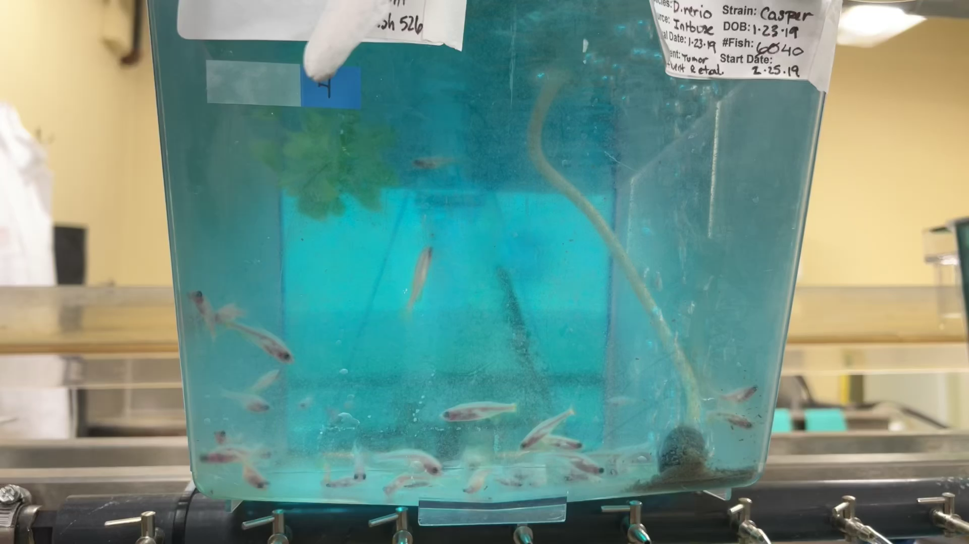

Slide 8
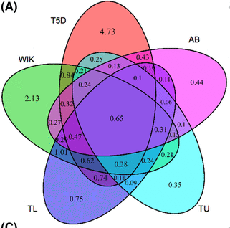
Strains introduce non-protocol induced variation
7% (inbred) to 37% (wild type) interstrain genetic variation
Cofounding variables affect disease outcomes

Slide 9
The zebrafish core gut microbiome is phylogenetically diverse
We’ve looked at core microbiome across exposures
Number of core clades found across ZF facilities and studies
Some clades sensitive to types of exposures
Strain effects?
Notes:
the top 25% most prevalent clades are members of the Gammaproteobacteria, Fusobacteria, Bacteroidetes, and Alphaproteobacteria.
We found that 200 core clades were insensitive to any exposure we assessed, while 134 core clades were sensitive to more than two exposures.
The lower left cladogram illustrates the phylogenetic location of each of the core clades detected in our analysis, where node color corresponds to the overall prevalence of each core clade. The ring of colors encircling the cladogram illustrates each ASV’s phylum level taxonomy. The clade to the immediate right illustrates the number of exposures to which each of these core clades is sensitive, as measured by negative binomial regression models. The smaller cladograms near the top illustrate which clades are sensitive to specific exposures (fdr < 0.1).

Slide 10
Pseudocapillaria is a common ZF facility pathogen

Slide 11
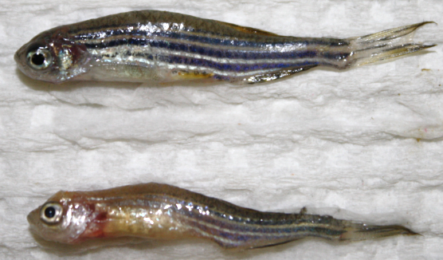
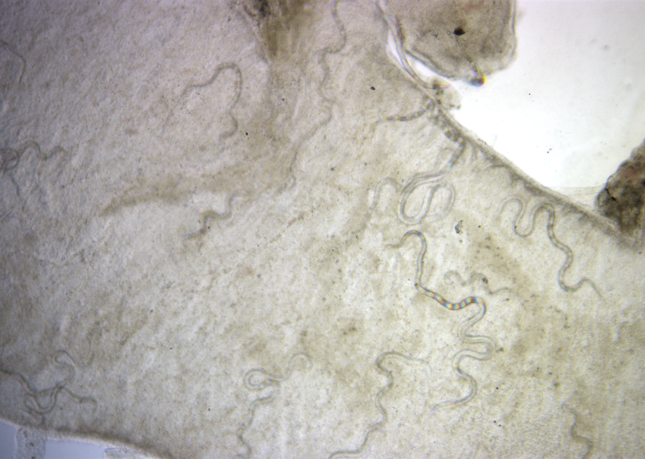
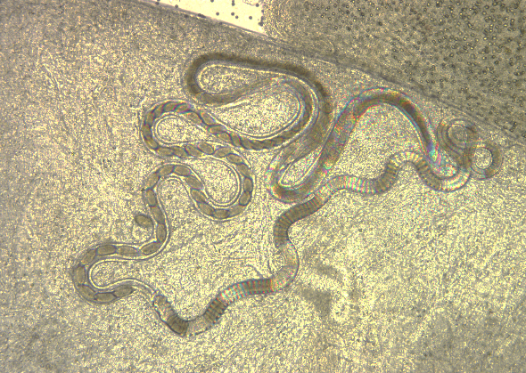
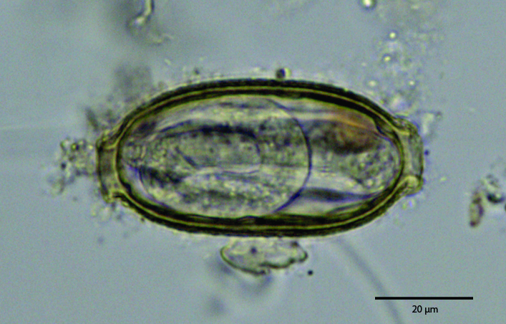
Pseudocapillaria tomentosa (P capp)
Notes:
Pseudocapillaria tomentosa or (P capp) is an intestinal parasitic nematode that is found in the intestines and can cause severe inflammation and tumors in the gut.
In ZF it has adverse effects on nutrient absorption and other endpoints related to metabolism, growth and the ability to survive.

Slide 12
Is there a relationship between microbiome, host strain and parasite infection?
Strain
?
?
?
Microbiome
Infection
Notes:
There is a lot of motivation to better understand the influence of host genetics on parasite infection susceptibility and microbiome composition.
Because if some strains are more sensitive to parasitic infection either physiologically or their microbiome, then it could help inform the ZF research community conducting research using various strains. It would also illuminate how much, if any, the role of host genetics plays on microbiome composition in ZF and how that's intertwined with parasite infection.
This would be important for researchers to know for designing experiments and comparing results across studies. Additionally, it could lead to the development of microbiome targeted diagnostic and therapeutic methods for identifying and treating parasitic infections in hosts.

Slide 13
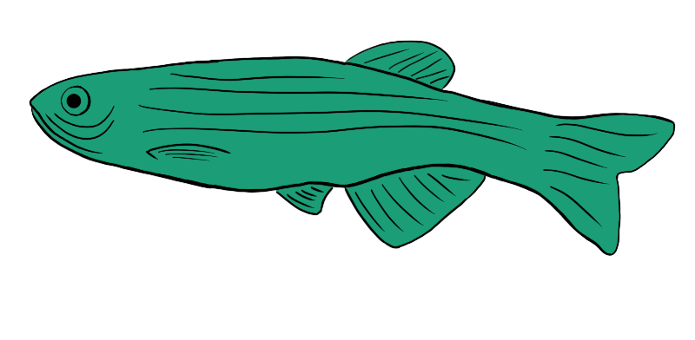
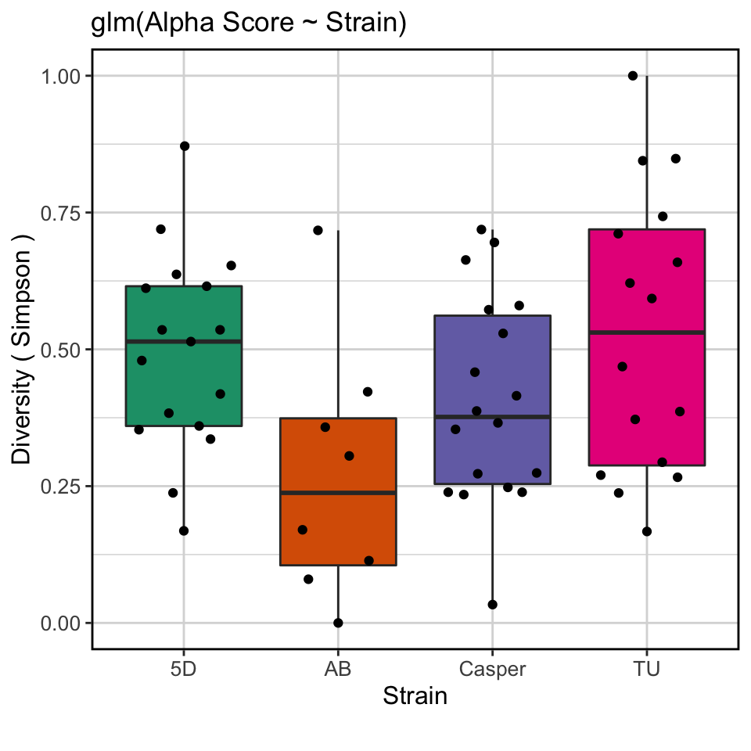

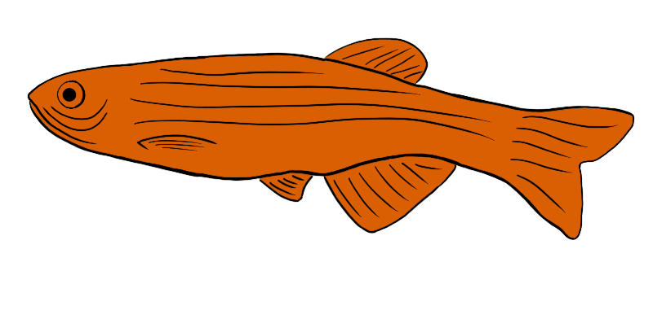

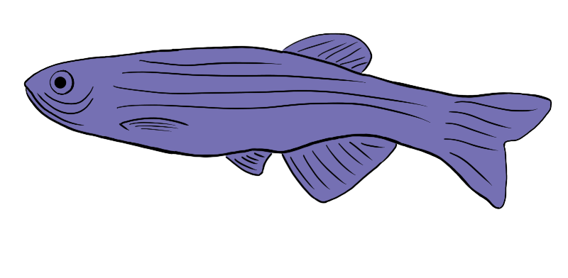
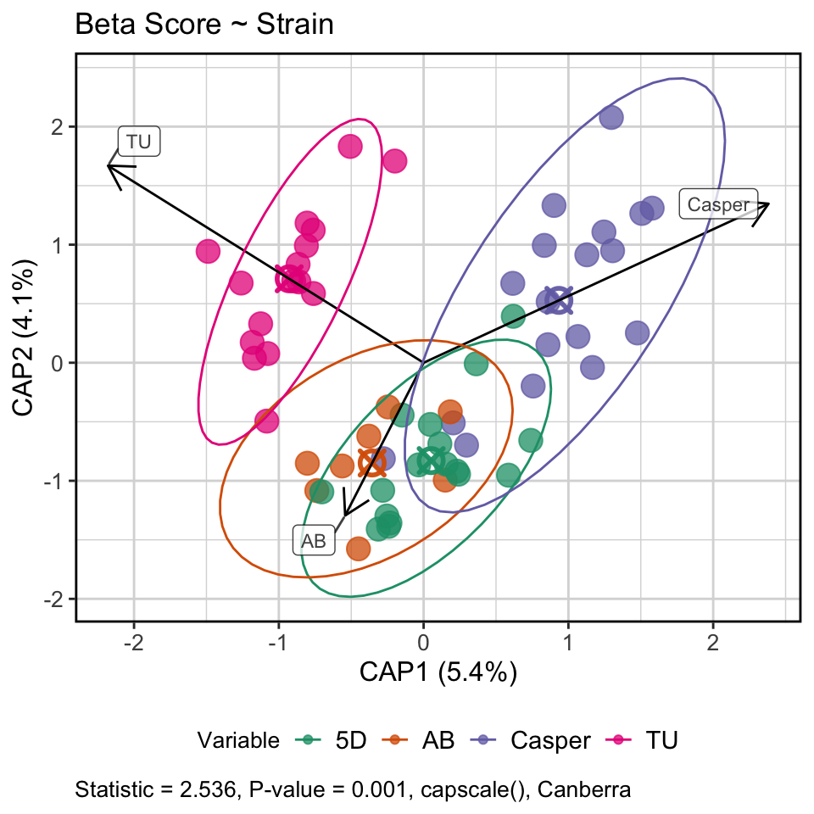
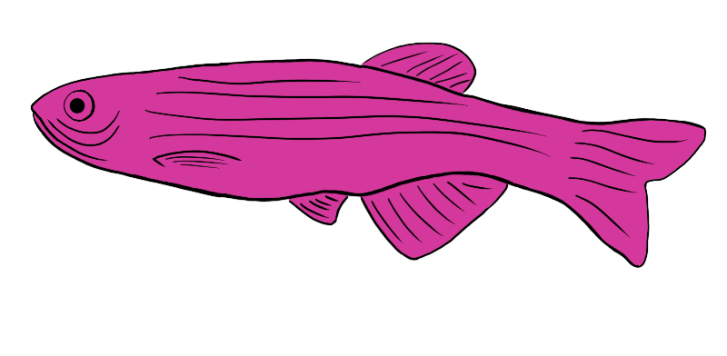
Experimental Design
5D
💩
AB
Casper
TU
Grown to adulthood (120 dpf)
Exposed to Pseudocapillaria tomentosa
(120 dpf)
Stool samples
(155 & 170 dpf)
(31 & 44 dpe)
16S sequencing
Microbiome
analyses

Slide 14
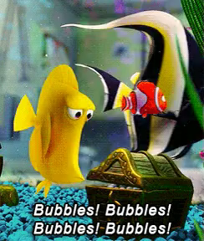
Bubbles! Unplanned non-protocol induced variation
Super-saturation event contaminated results for exposed fish
The rest of the results today will focus on control fish

Slide 15
Strains

Slide 16
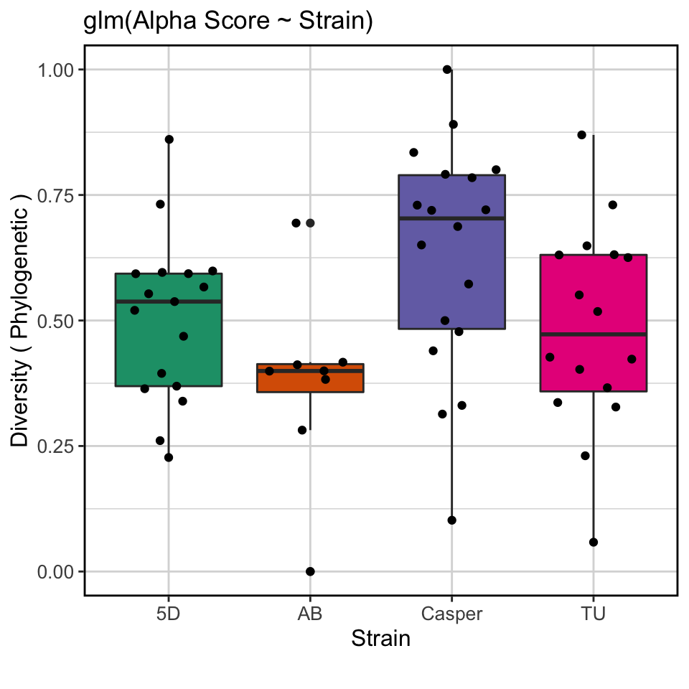
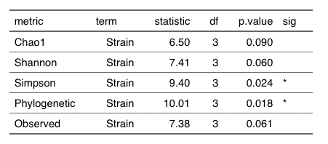
AB has fewer unique taxa, but Casper has more phylogenetically diverse taxa

Slide 17
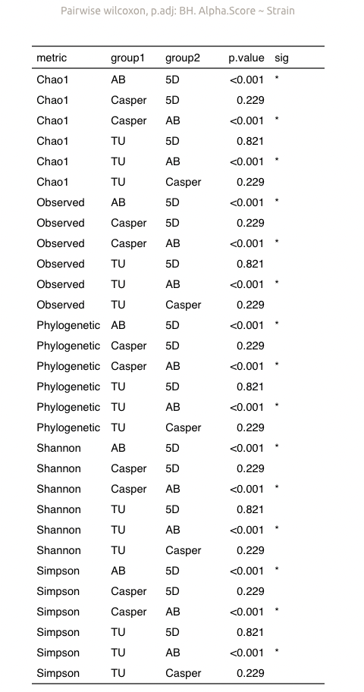
glm(alpha.score ~ strain)

Slide 18
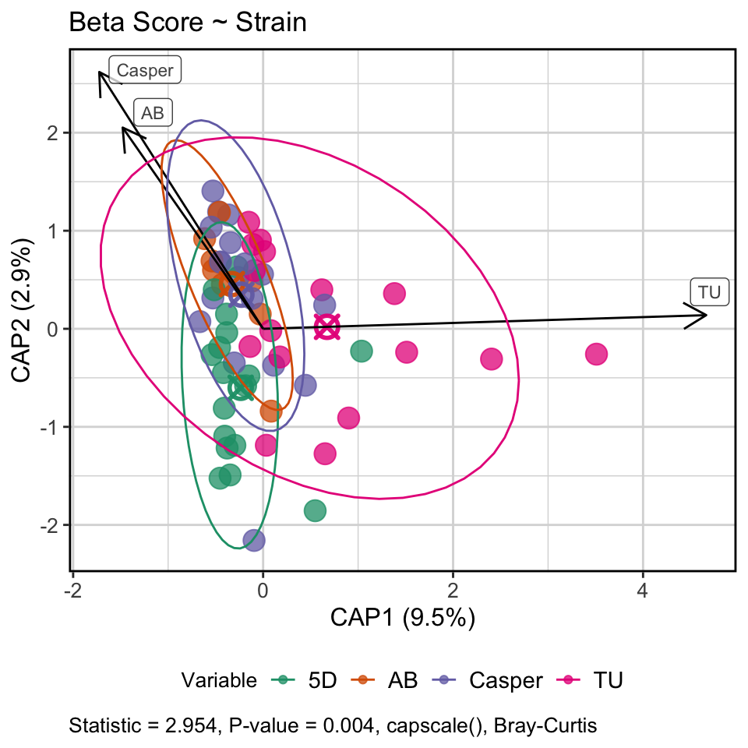
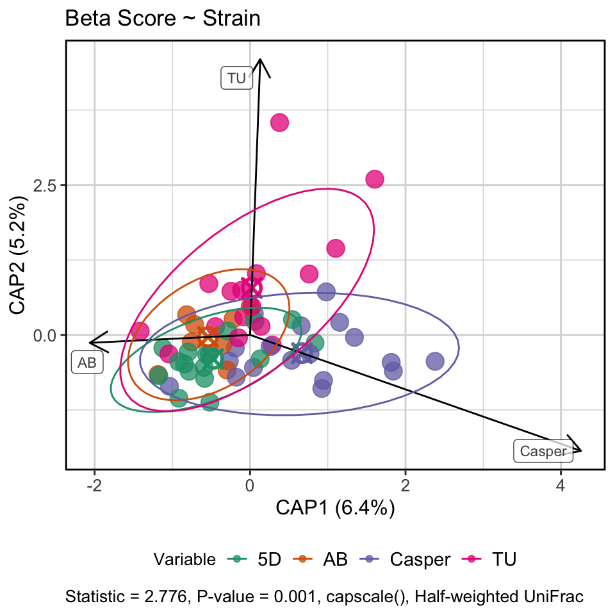
Composition of abundant taxa are more conserved across strains
Hom. Disp: Bray-Curtis, p-val = 0.058
Hom. Disp: Canberra, p-val = 0.042
Hom. Disp: Wunifrac, p-val = 0.081
(unifrac, p-val = 0.023)
Notes:
Dispersion weakly significant in bray Curtis, significant in canbera, sig in unweighted unifrac but weakly sig in weighted

Slide 19
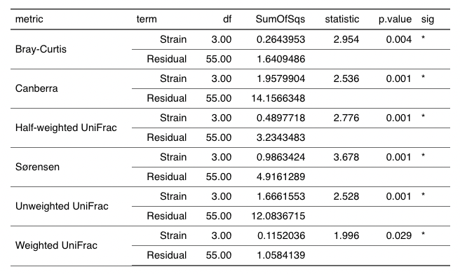

Slide 20
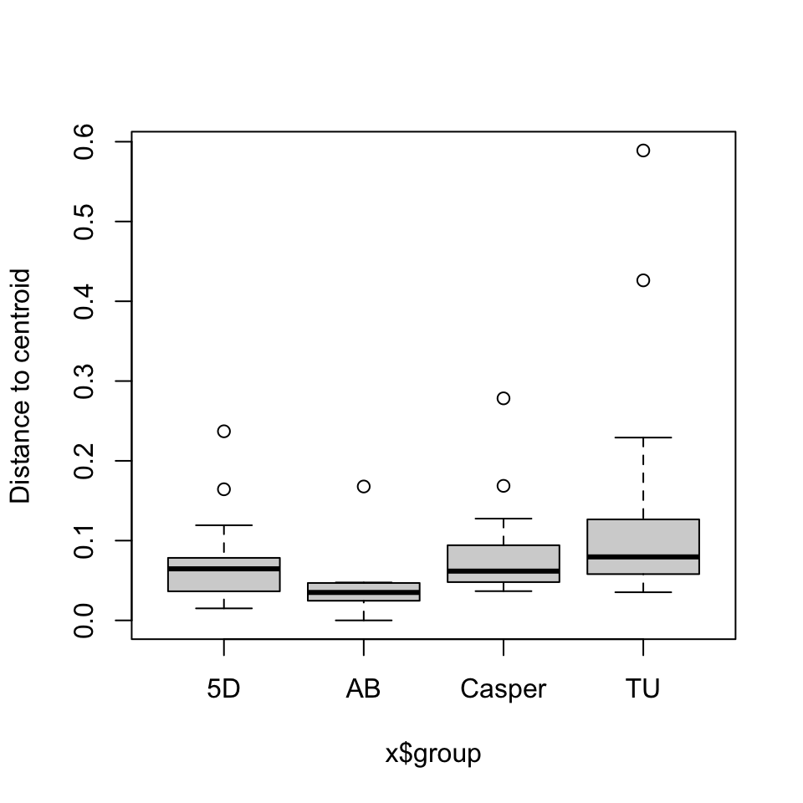
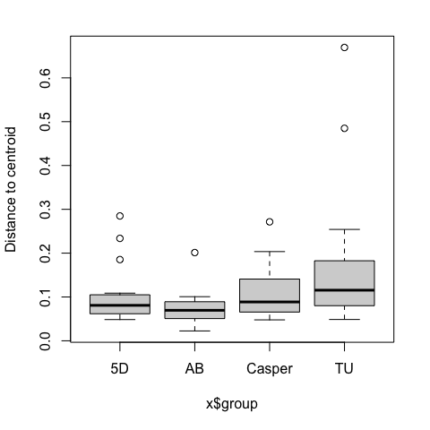
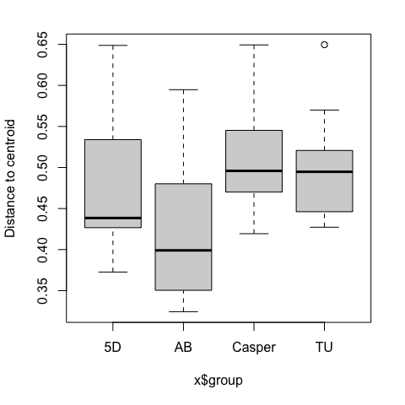
More dispersion in rarer taxa in AB compared to TU and Casper
Hom. Disp: Bray-Curtis, p-val = 0.058
Hom. Disp: Canberra, p-val = 0.042
Hom. Disp: Wunifrac, p-val = 0.081
(unifrac, p-val = 0.023)

Slide 21
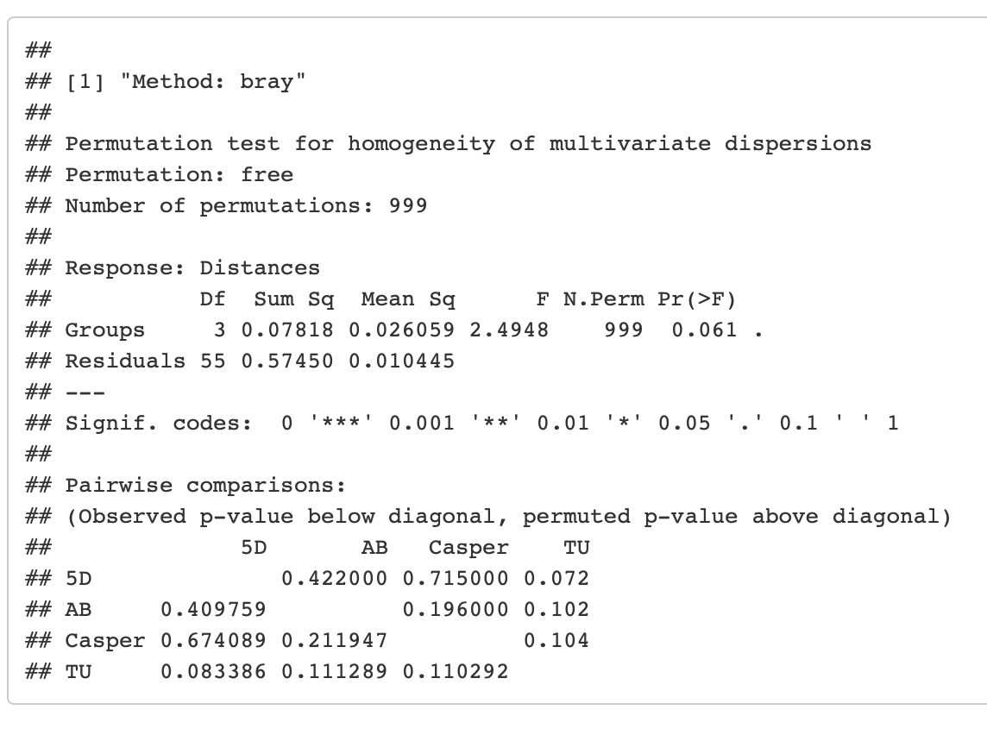
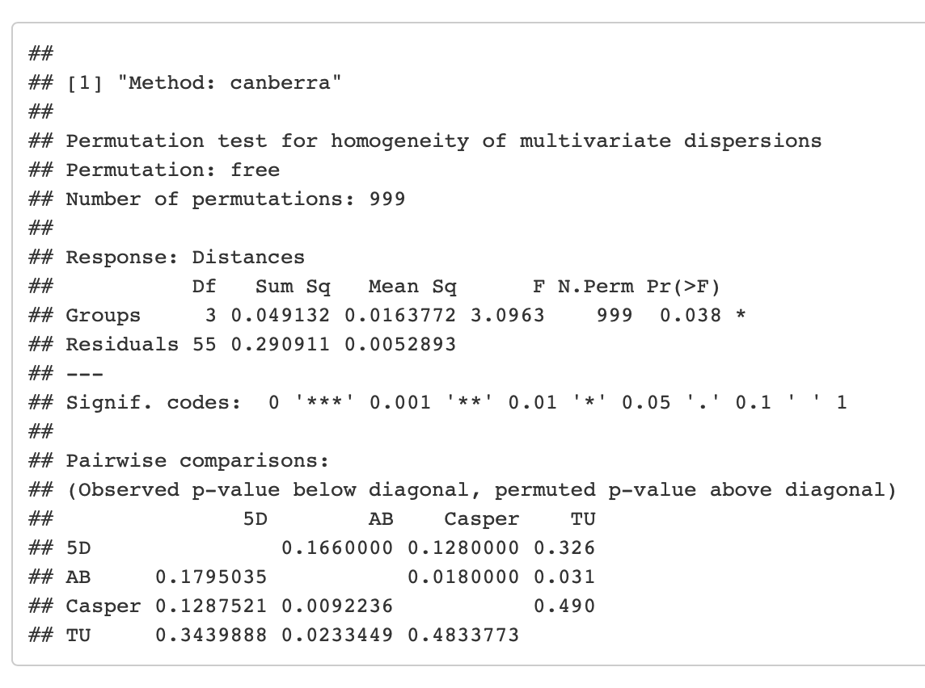
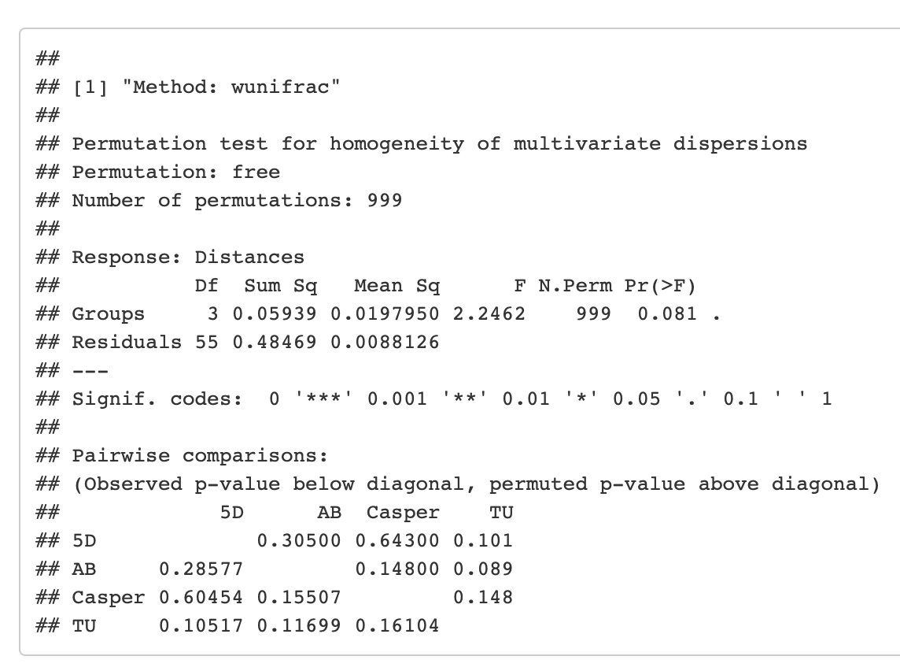
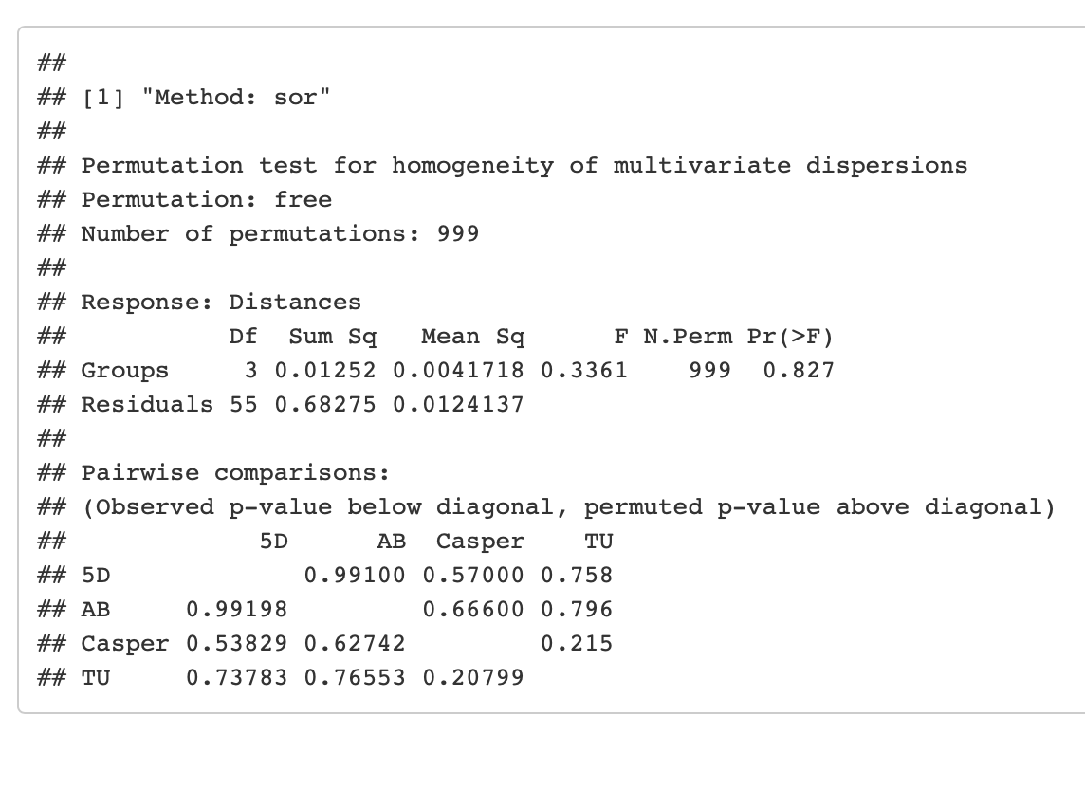
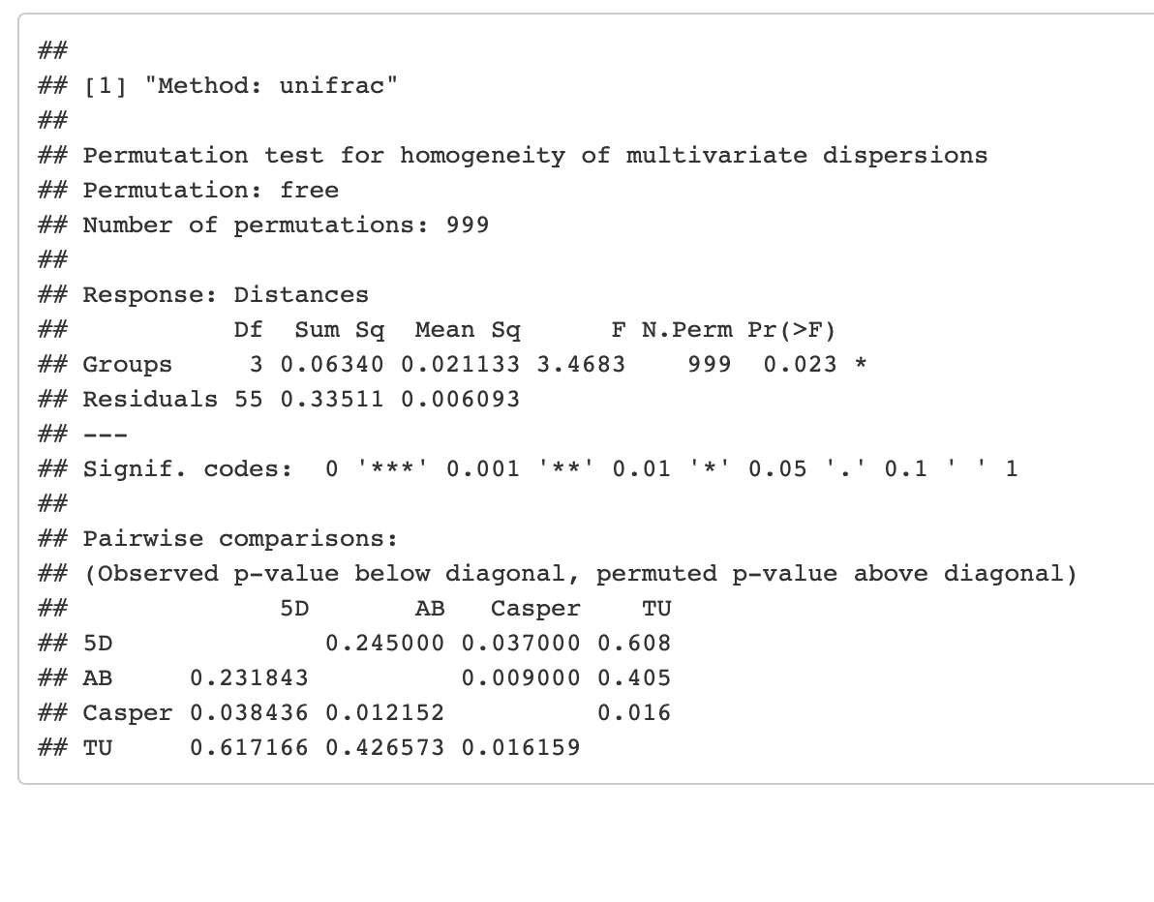

Slide 22
Time

Slide 23
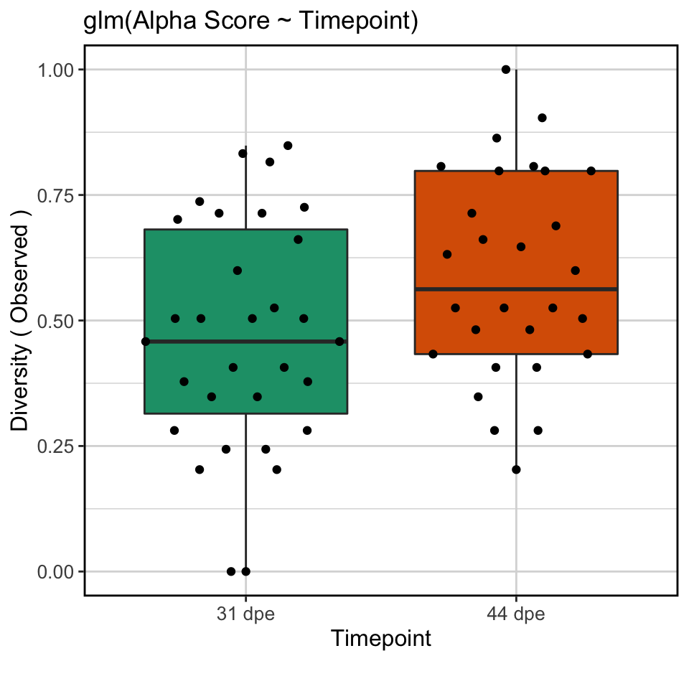
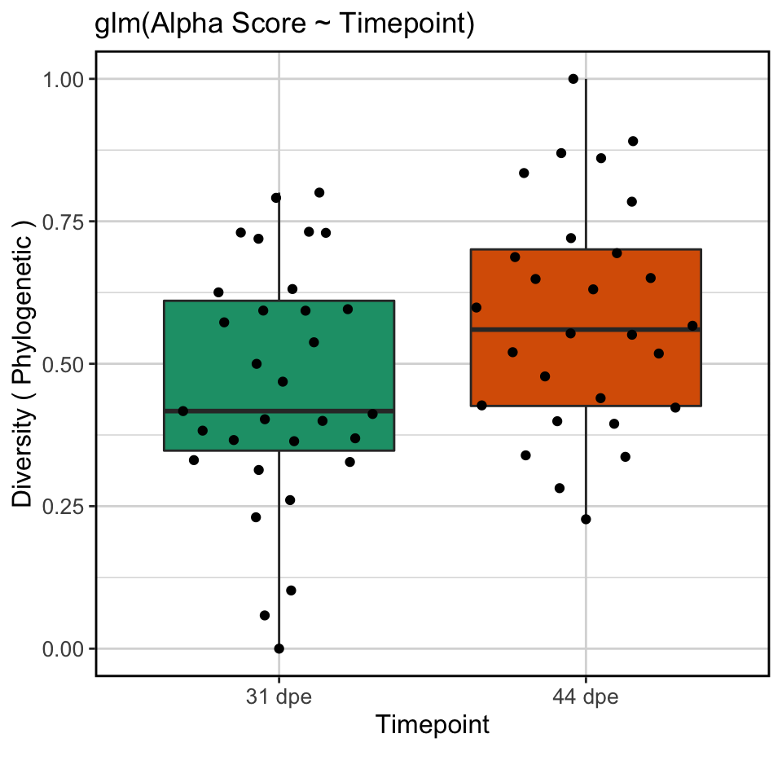
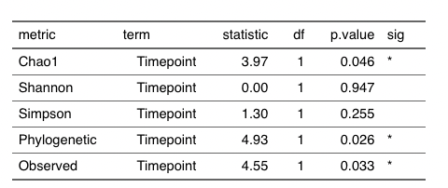
Time
Notes:
Strain:Timepoint not significant

Slide 24
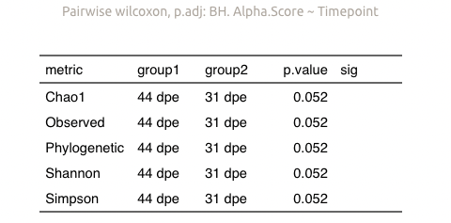

Slide 25
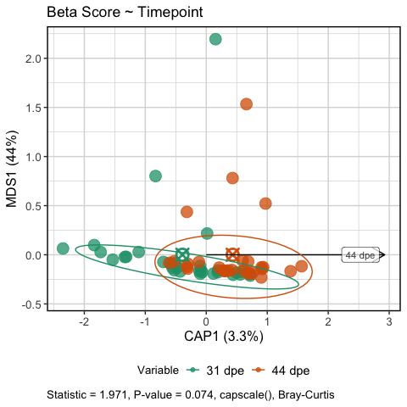
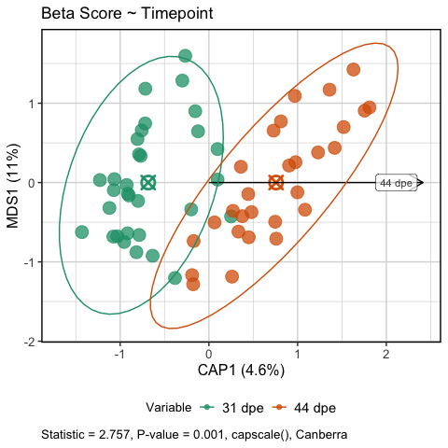
Time driving composition in rarer taxa
Hom. Disp: Bray-Curtis, p-val = 0.59
Hom. Disp: Bray-Curtis, p-val = 0.175
Notes:
Strain:Timepoint not significant

Slide 26
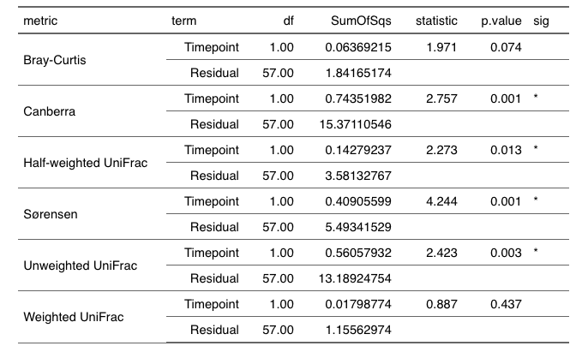

Slide 27
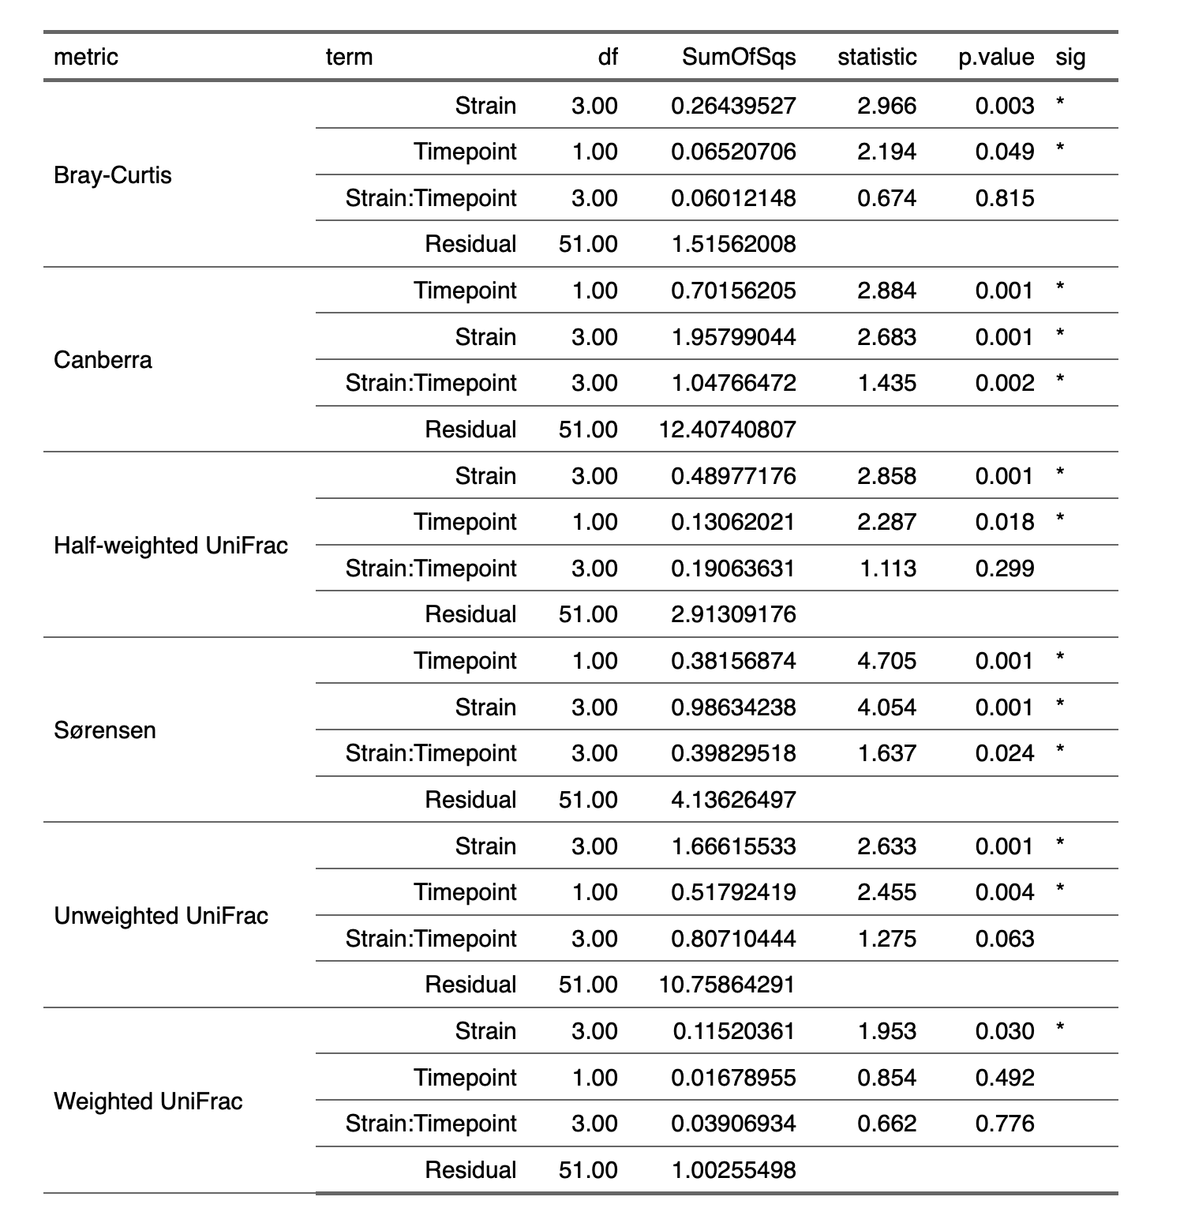
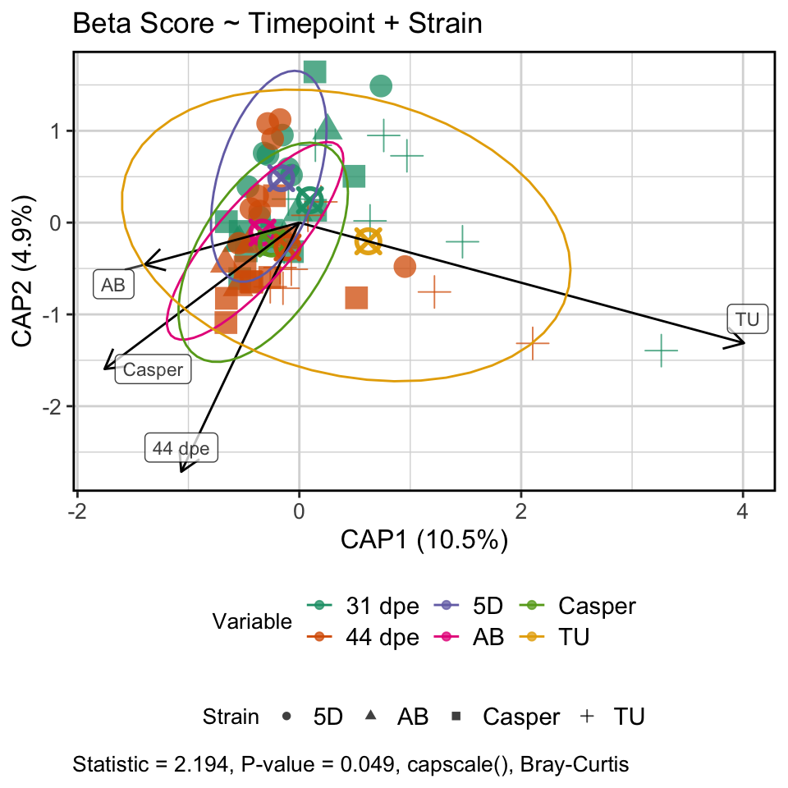
Time:Strain not significant

Slide 28
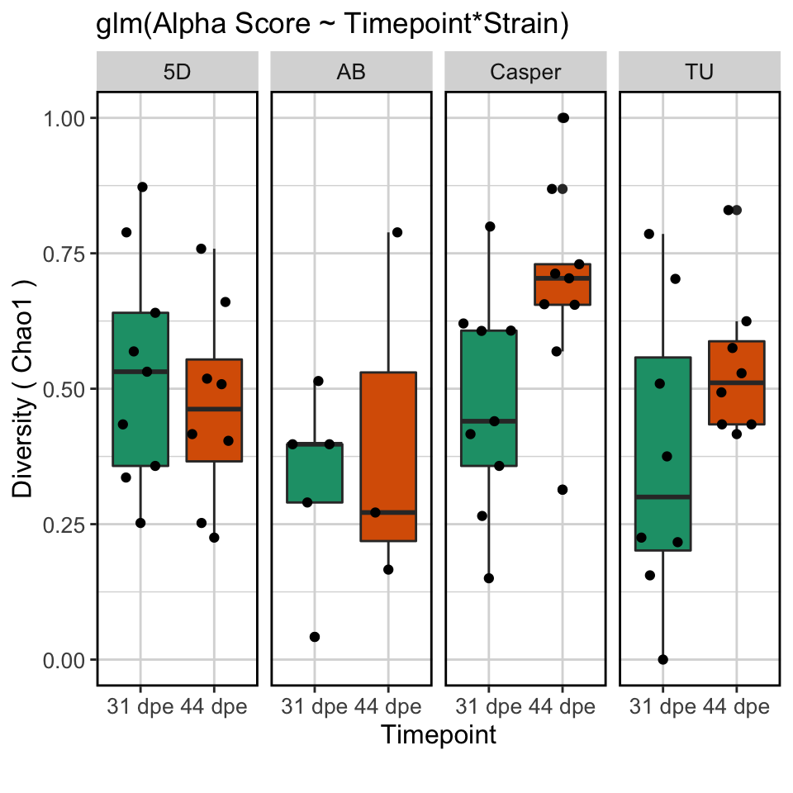
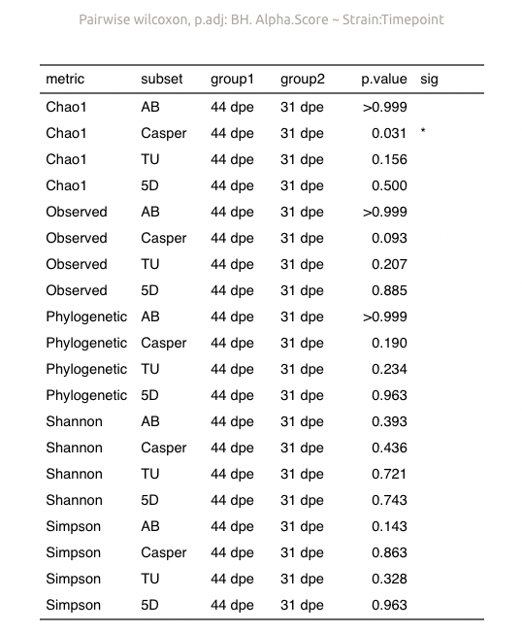
No time by strain time interaction effect

Slide 29
Sex

Slide 30
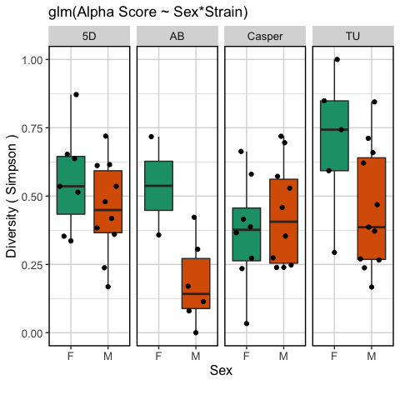
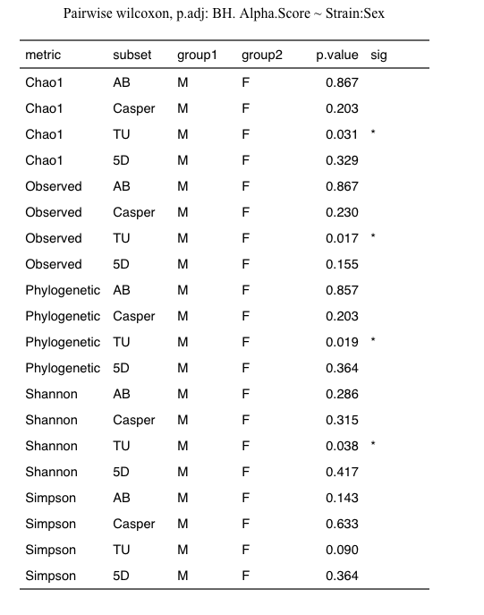
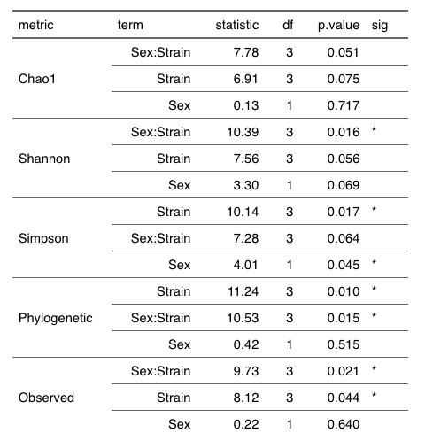
Females have higher alpha diversity in TU
glm(Alpha.Score ~ sex:strain)

Slide 31
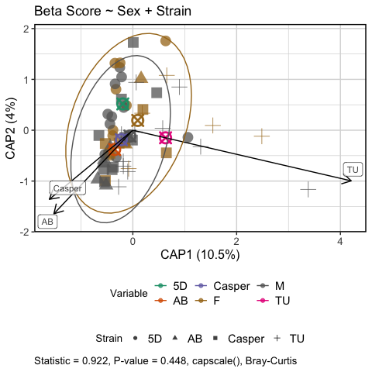

Strain overwhelms any sex effects in microbiome composition

Slide 32
Summary of results
Strain plays a role in microbiome diversity and composition
AB fish had lower alpha diversity scores compared to others
Composition of abundant taxa don’t appear to be affected by strain, but rarer taxa are
Dispersion is lowest in rarer taxa in AB strain
Time influences composition in rarer taxa
This tracks with diet study
Female TU fish had higher alpha diversity than males, other strains weren’t different
No differences in microbiome composition between sexes

Slide 33
Conclusion
Microbiome largely conserved across strains, but differ in diversity and composition of rarer taxa
Supports the ability to integrate microbiome data across zebrafish microbiome studies so long as you’re mindful of rarer taxa

Slide 34
Future directions?
Mike is considering repeating the study
Publish a letter noting our observations

Slide 35
Questions?
As always, thank you to Kristin, Keaton, Colleen, Corbin, Mike and Tom for their help with this study

Slide 37


No sex effects observed

Slide 39


Pathogen exposure not a significant predictor of microbiome diversity

Slide 40


Slide 41


Presence of worms not a significant predictor of microbiome diversity

Slide 43



Composition stratifies by treatment, but could this be super sat?

Slide 44


Slide 45



Presence/absence of worms not a significant predictor of microbiome composition

Slide 46



Slide 47




Tank Effects: Diversity (Control Samples)? lme4::glmer( formula = "Alpha.Score ~ Strain + (1 | Tank.ID)"

Slide 49




Tank Effects : Diversity (all samples)? lme4::glmer( formula = "Alpha.Score ~ Strain + (1 | Tank.ID)"

Slide 51


Tank Effects: Composition (all)? capscale(beta.div ~ Tank.ID)

Slide 52


Slide 53
Feedback
What differences in physiology or metabolism between strains
Toll like receptors
Immune differences between strains?
Bio geographical environment
Developmental differences
Differences in behavior, feeding
What are the drivers of the statistical effect. Kitchen sink
!!! ANCOM try it out, naive vs ancomVC (improved). Downside: aitchenson distance
Think about various alternative hypotheses for a pattern you’re seeing. Create a list. Order by parsimony or likelihood. Come up with an experimental design to rule out these alternative hypotheses.

